Slide 1

File Encryption / Decryption Tool & The Password Generator
Group B70

Slide 2
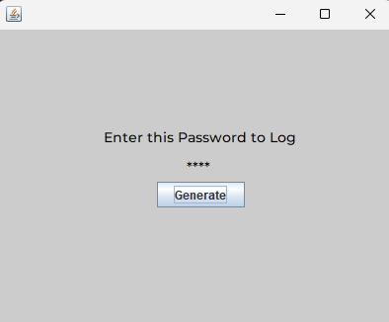
Password Generator

Slide 3
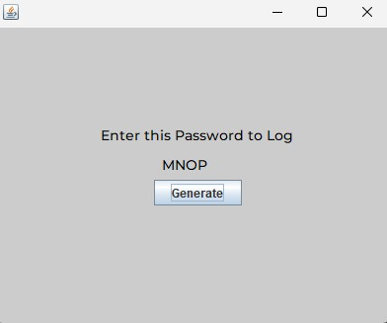
Password Generator

Slide 4
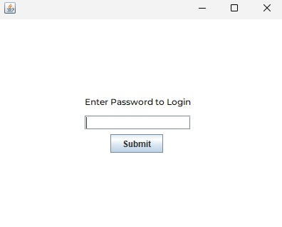
Login

Slide 5
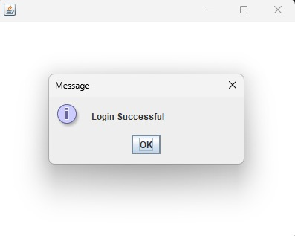
Login Successful

Slide 6
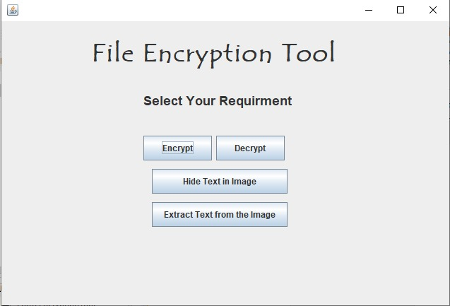
Home Page

Slide 7
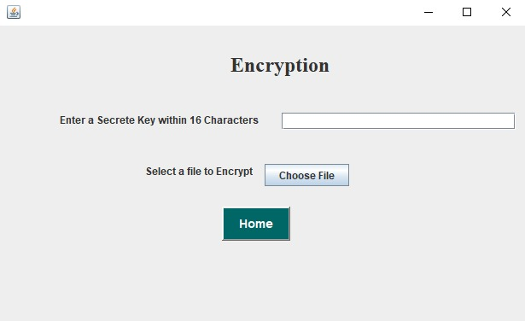
Encryption

Slide 8
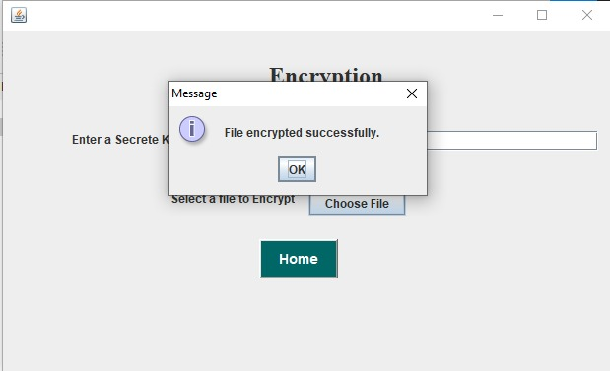
Encryption Success

Slide 9
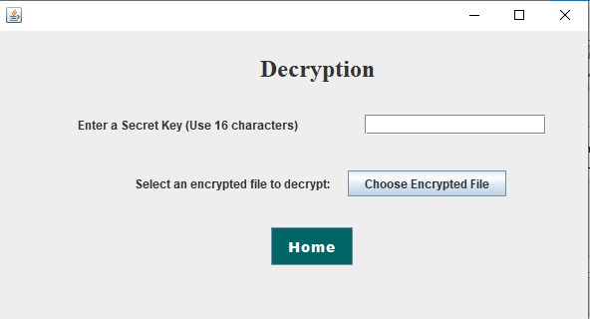
Decryption

Slide 10
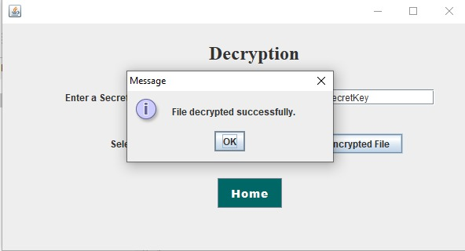
Decryption Success

